Slide 1
Machine Learning

Slide 2
Big Data
The term Big Data probably originated in the lunch-table conversations at Silicon Graphics in the mid-1990s. Some gave credit to John Mashey for popularizing the term.

Slide 3
Big Data
Big Data: A Revolution that Will Transform How We Work, Live and Think
Viktor Mayer-Schönberger
Kenneth Cukier
Volume
Velocity
Variety
Veracity

Slide 4
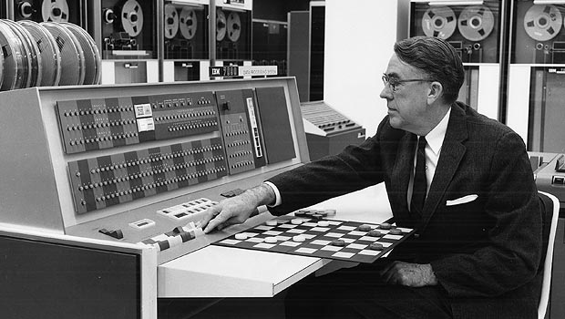
Machine Learning
Arthur Lee Samuel coined the term "machine learning" in 1959.

Slide 5
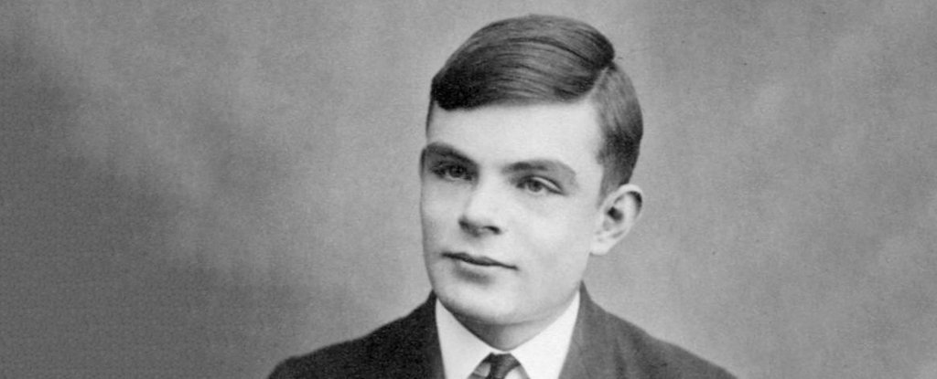
Artificial Intelligence
Alan Turing is widely considered to be the father of theoretical computer science and artificial intelligence.

Slide 6
Artificial Intelligence
Back in the 1950s, the fathers of the field Marvin Minsky and John McCarthy, described artificial intelligence as any task performed by a program or a machine that, if a human carried out the same activity, we would say the human had to apply intelligence to accomplish the task

Slide 7
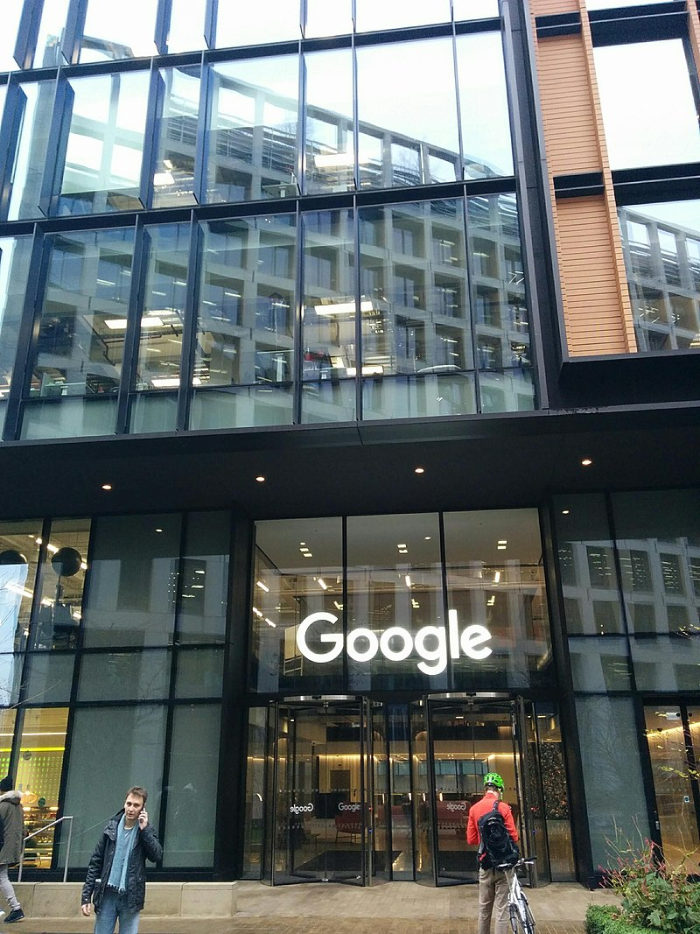
DeepMind

Slide 8
DeepMind
In October 2015, a computer Go program called AlphaGo, developed by DeepMind, beat the European Go champion Fan Hui.
AlphaGo used two deep neural networks: a policy network to evaluate move probabilities and a value network to assess positions.
1202 CPU and 176 GPU

Slide 9
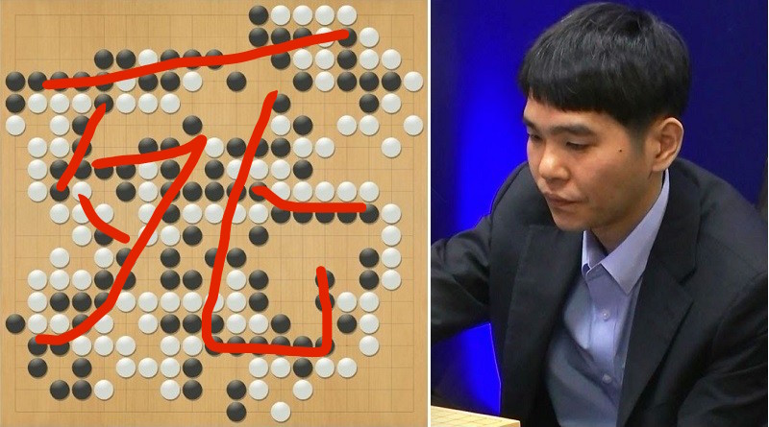

Slide 10
Machine Learning
Machine
Model
Learning (Mining)
Estimating

Slide 11
Supervised vs. Unsupervised
Supervised : All data is labeled and the algorithms learn to predict the output from the input data.
Classification
Regression
Unsupervised : All data is unlabeled and the algorithms learn to inherent structure from the input data.
Clustering

Slide 12
Train vs. Test
Train
Exploratory
Test
Confirmatory

Slide 13
Software
C/C++ (different)
Python
R
SPSS
EXCEL

Slide 14
Python
Use Python version 3
At command prompt:
python -m pip install numpy
python -m pip install scipy
python -m pip install matplotlib
Type in “python” to check the version

Slide 15
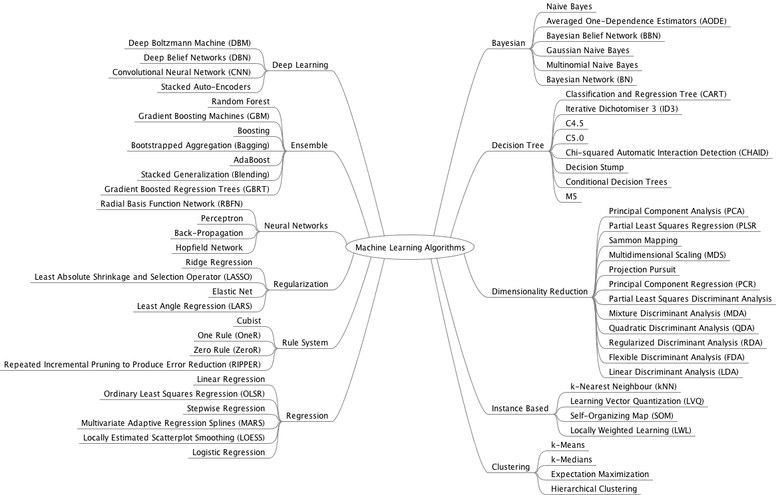

Slide 16
Essential ML Algorithms
Linear Regression
Logistic Regression
Linear Discriminant Analysis
Decision Trees
Random Forest
K-Nearest Neighbors
Support Vector Machines
Naive Bayes
Boosting and AdaBoost
Principle Component Analysis

Slide 17
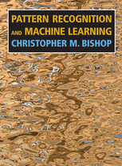
Useful References

Slide 18
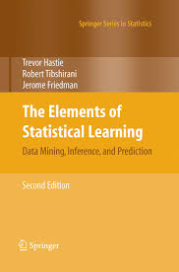
Useful References

